Slide 1
CHAPTER 6
KINETICS OF A PARTICLE: FORCE AND ACCELERATION

Slide 2
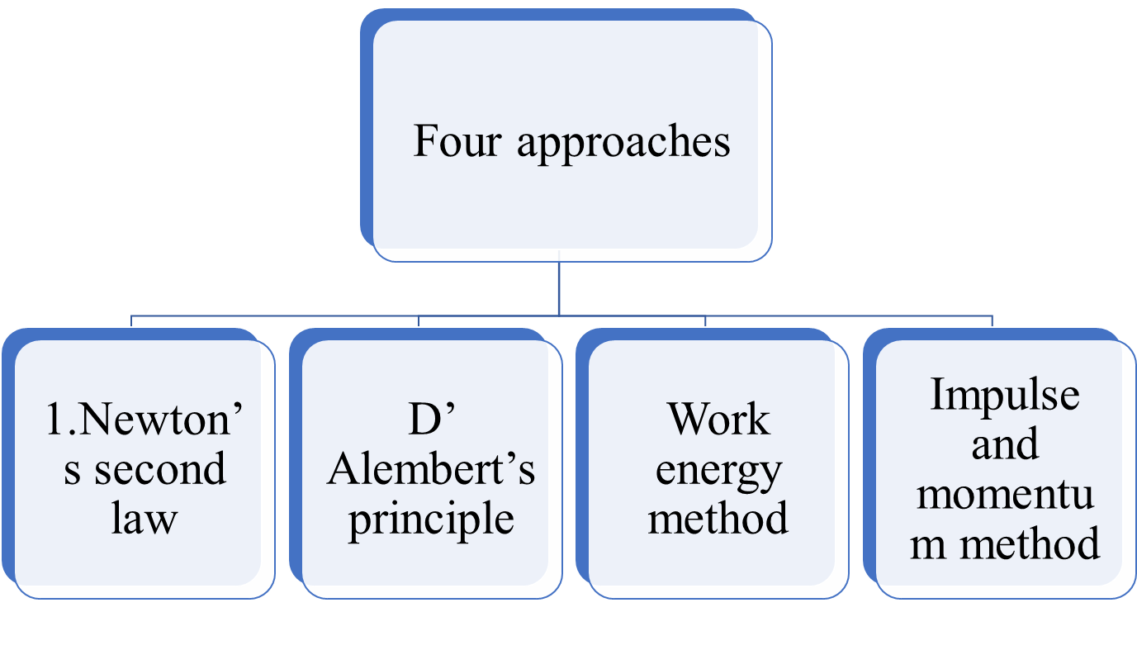
Four approaches to the solution of kinetics problems.

Slide 3
NEWTON’S LAWS OF MOTION
The motion of a particle is governed by Newton’s three laws of motion.

Slide 4
Newton's First Law
Newton's First Law states that an object will remain at rest or in uniform motion in a straight line unless acted upon by an external force.
It may be seen as a statement about inertia, that objects will remain in their state of motion unless a force acts to change the motion.

Slide 5
Second Law:
If the resultant force on the particle is not zero, the particle experiences an acceleration in the same direction as the resultant force.
This acceleration has a magnitude proportional to the resultant force.

Slide 6
Second Law:
The acceleration of an object as produced by a net force is directly proportional to the magnitude of the net force, in the same direction as the net force, and inversely proportional to the mass of the object.

Slide 7
Third Law:
For every action, there is an equal and opposite reaction.

Slide 8
NEWTON’S LAWS OF MOTION
The first and third laws were used in developing the concepts of statics.
Newton’s second law forms the basis of the study of dynamics.

Slide 9
Mathematically, Newton’s second law of motion can be written
F = ma
Where,
F is the resultant unbalanced force acting on the particle
a is the acceleration of the particle.
m is called the mass of the particle.

Slide 10
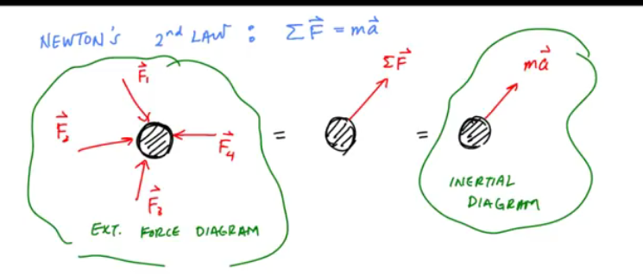

Slide 11
Coordinate system
Cartesian or rectangle
Normal and tangential
Radial and transverse

Slide 12
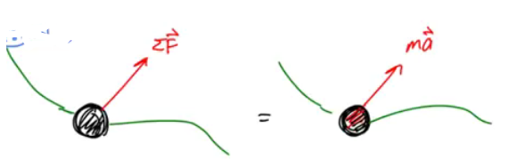
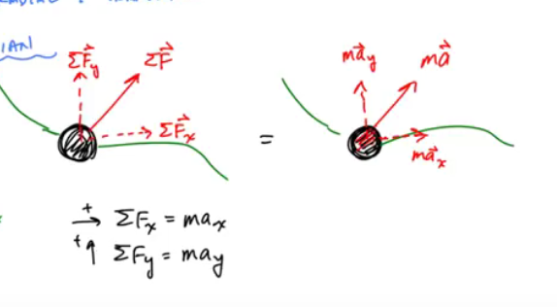
1.Cartesian or rectangle coordinate system

Slide 13
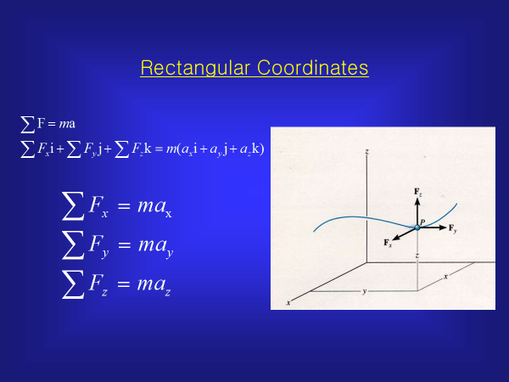

Slide 14
Particular cases
When the resultant force is zero, acceleration of the particle is also zero.
When v_{o} = 0,the particle remains at rest (i.e v = 0)
If particle is originally moving with, v = v_{o}, it will move with the constant speed vo along a straight line.

Slide 15
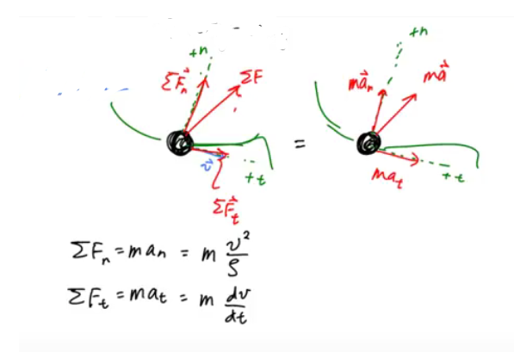
2.Normal and tangential coordinate system

Slide 16
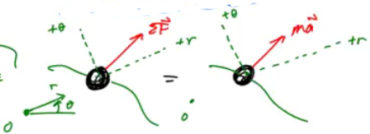
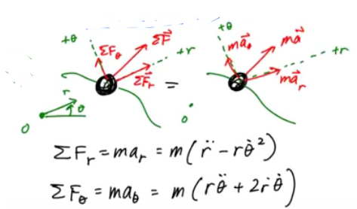
3.Radial and transverse coordinate system

Slide 17
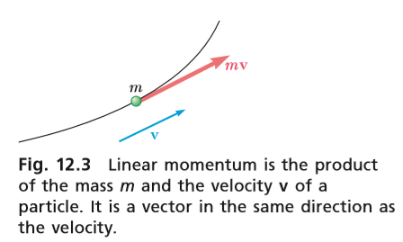



Linear momentum and rate of change
According to Newton’s second law,
F = ma

Slide 18
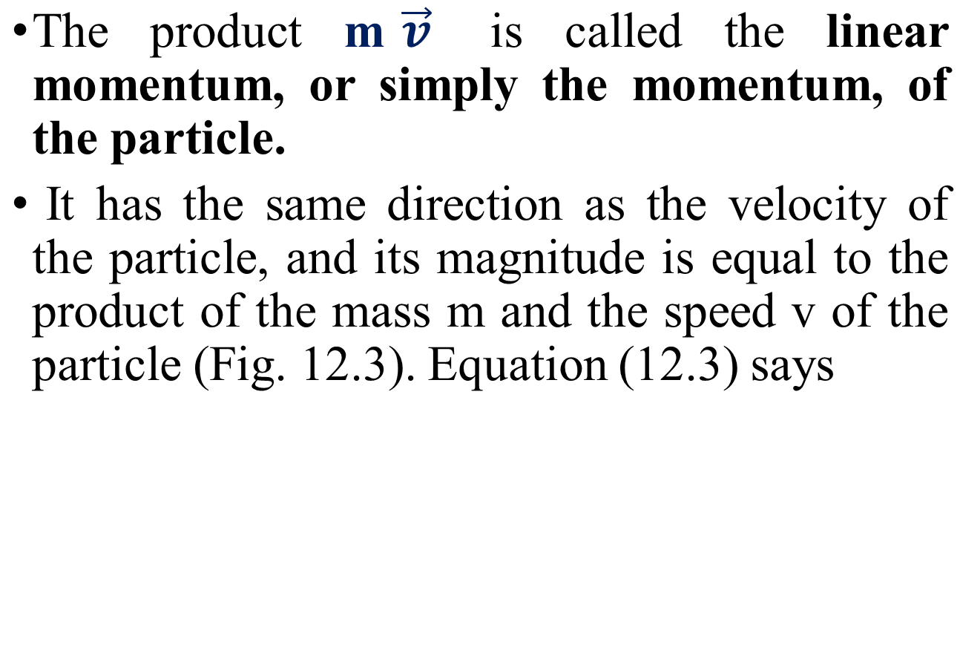


Slide 19
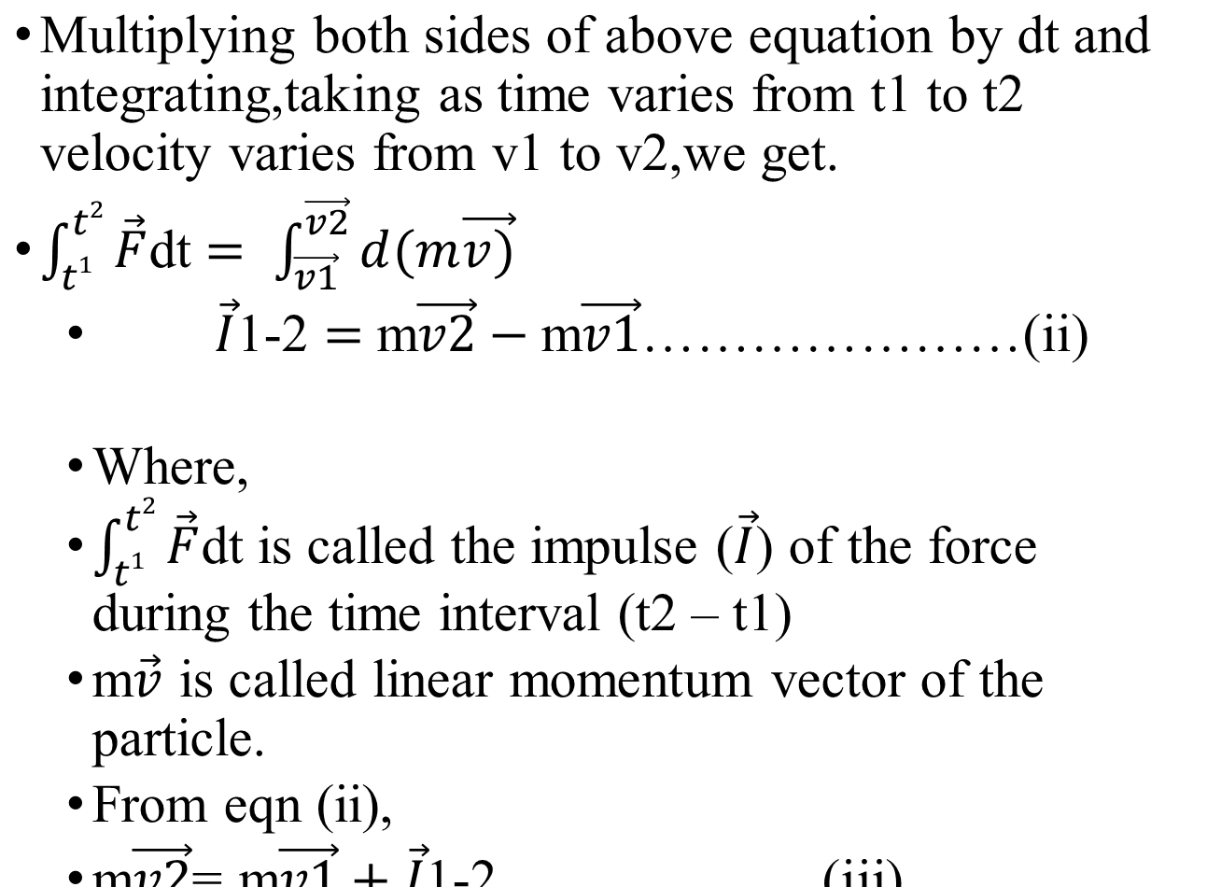

Slide 20
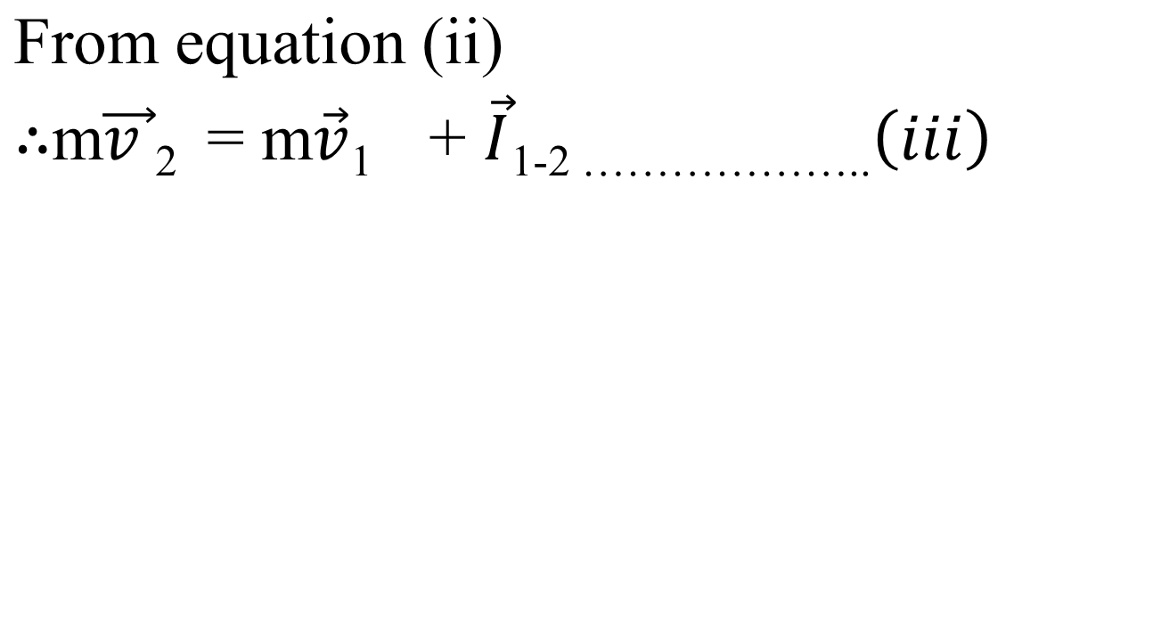

Slide 21
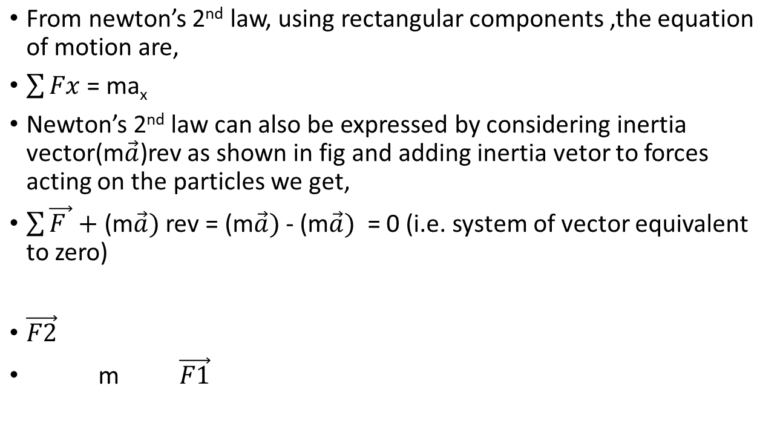




Equation of motion and dynamic equilibrium
m

Slide 22
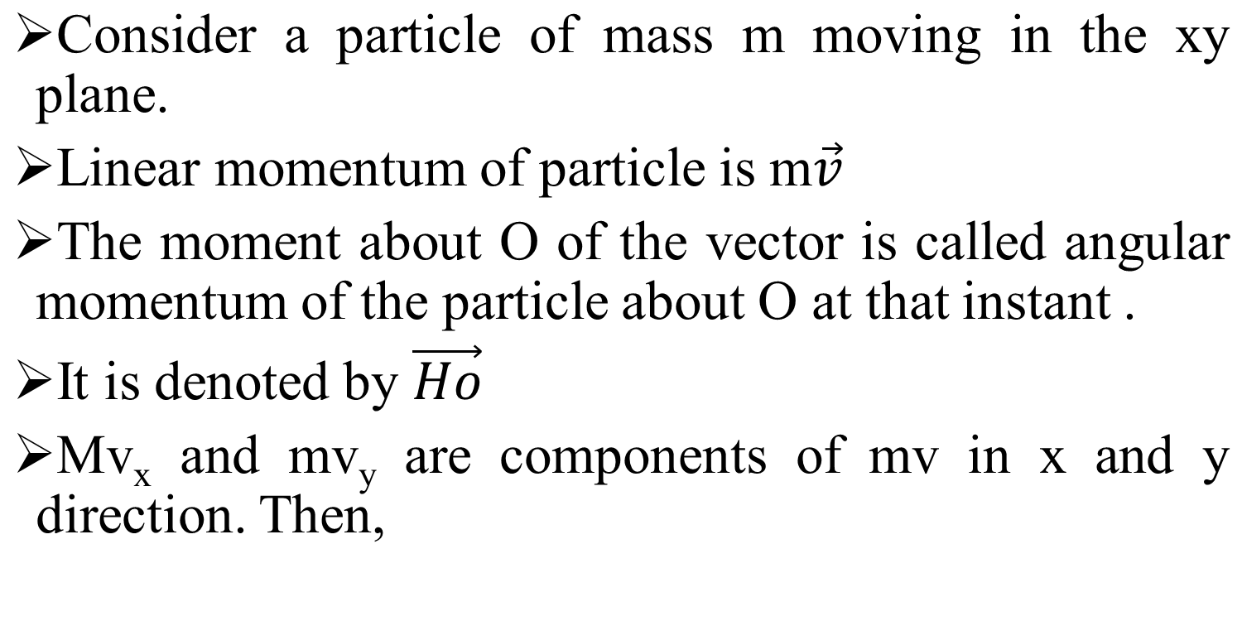
Angular momentum and rate of change

Slide 23
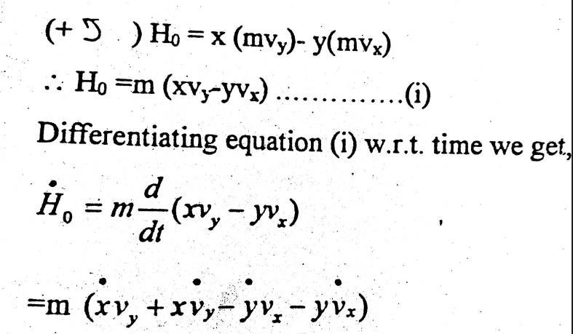

Slide 24
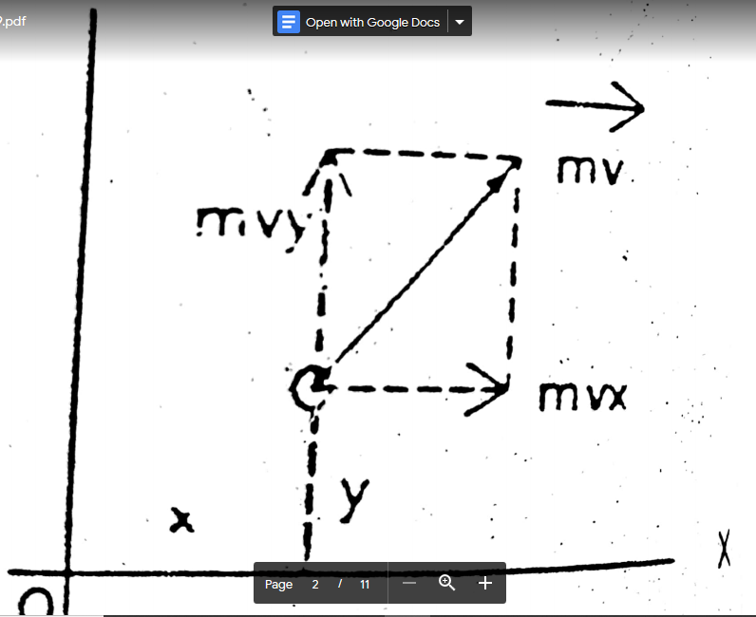

Slide 25
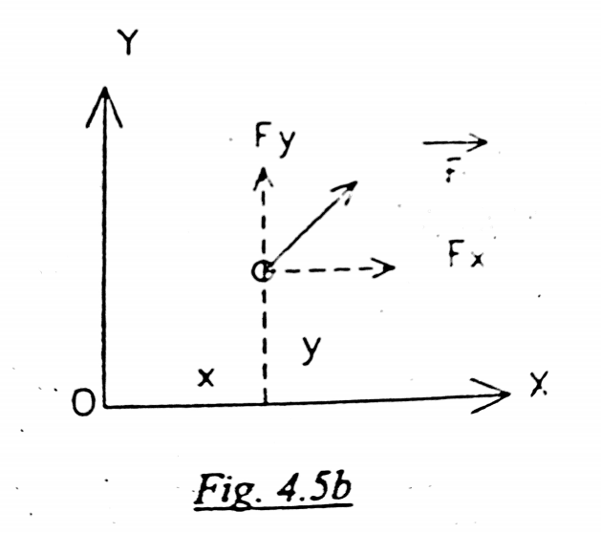

Slide 26
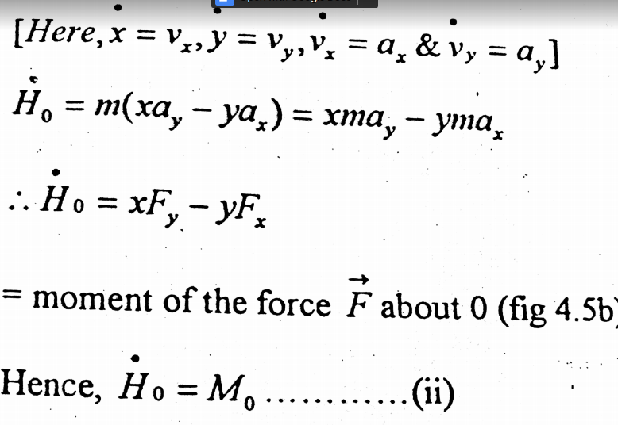

Slide 27
Thus the rate of change of angular momentum of the particle about any point at any instant is equal to the moment of the force acting on that particle about the same point.

Slide 28
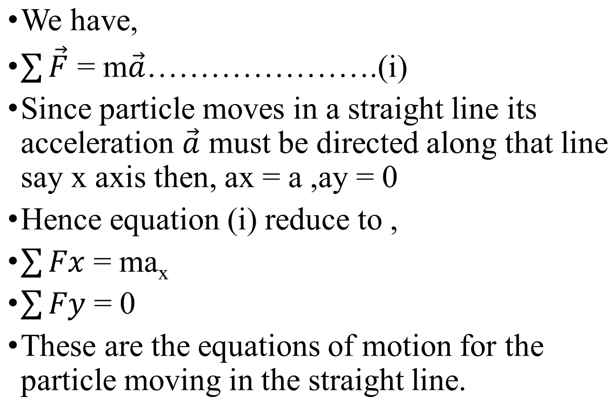
1.Rectilinear motion of particles

Slide 29
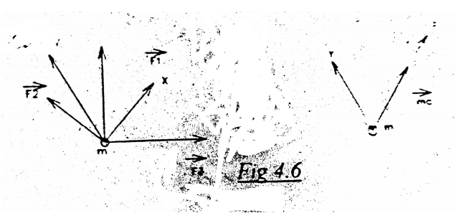

Slide 30
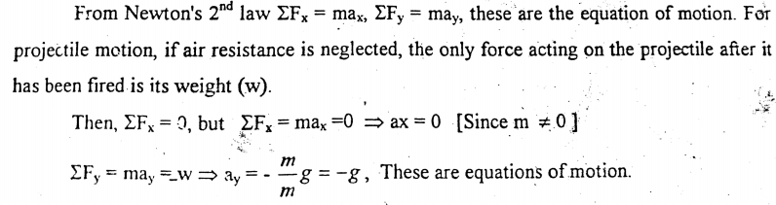
2.Curvilinear motion of particles
1. Rectangular components

Slide 31
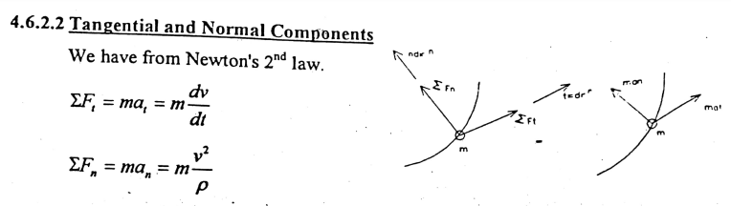
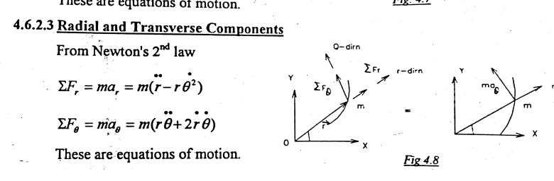

Slide 32
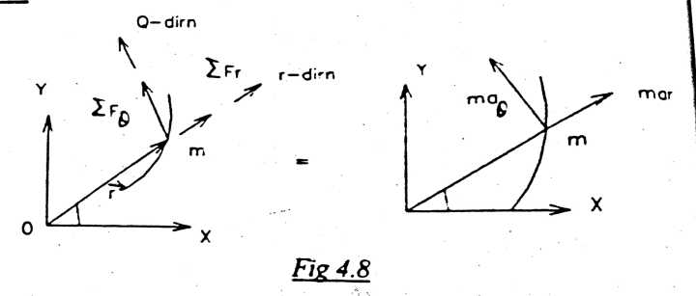
Radial and transverse component

Slide 33
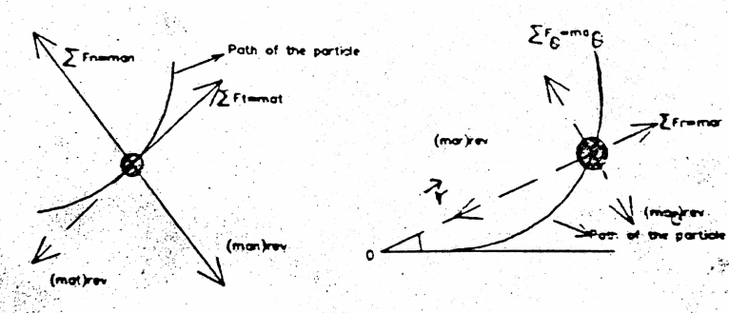
Dynamic Equilibrium
As we consider the inertia vector in the system , then the system will be balanced and the following equations can be obtained.

Slide 34
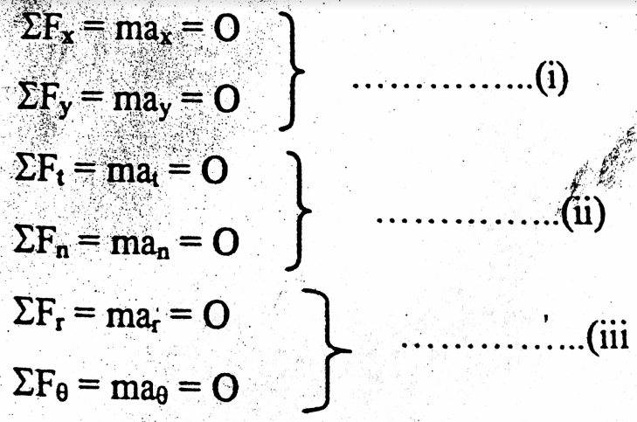

Slide 35
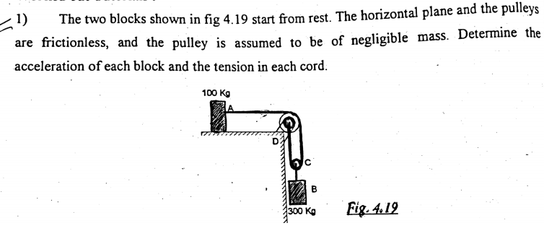
Numerical examples

Slide 36
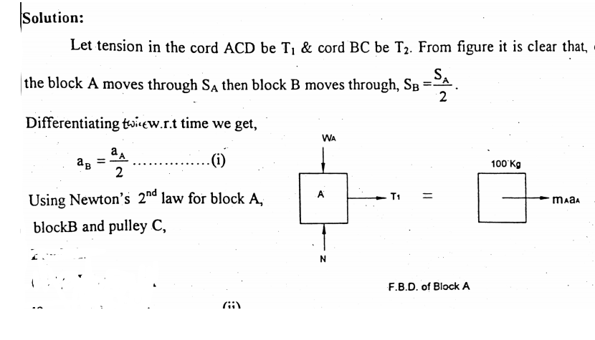

Slide 37
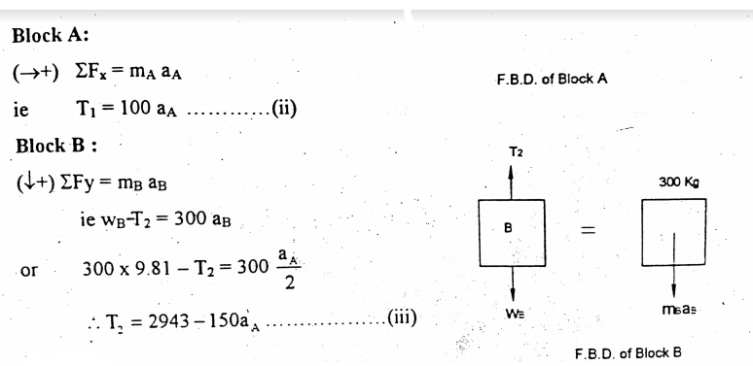

Slide 38
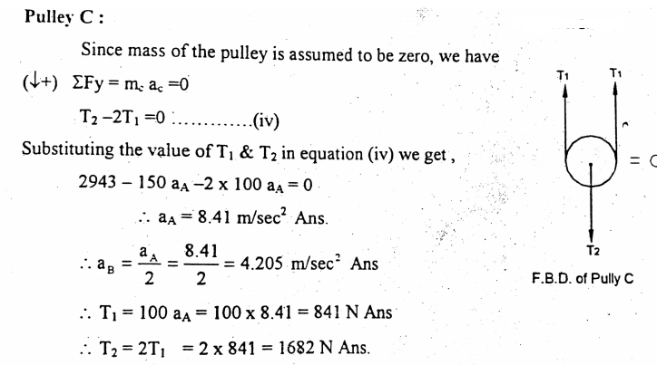

Slide 39
The bob of a 3m pendulum describes an arc of a circle , in a vertical plane. If the tension in the chord is 2 times the weight of the bob for the position when it is displaced through an angle of 30 degree from its mean position. Find the velocity and acceleration of the bob for this situation.

Slide 40
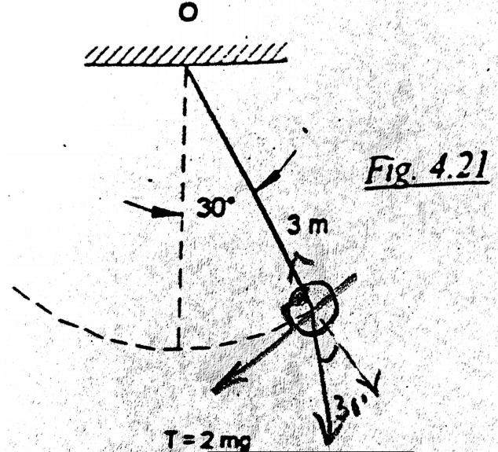

Slide 41
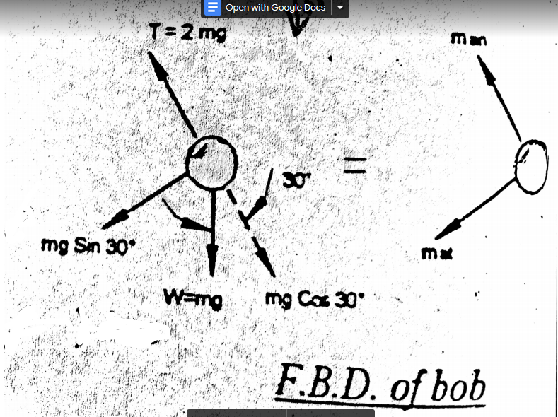

Slide 42
